Slide 1
Platform Evolution Azure Functions LogicApps
Damir Dobric
daenet CEO, Lead Architect
Microsoft Regional Director
Azure Most Valuable Professional
https://damirdobric.me

Slide 2
Platform Evolution
Damir Dobric
daenet CEO, Lead Architect
Microsoft Regional Director
Azure Most Valuable Professional
https://damirdobric.me

Slide 3
The “evolution” of application platforms
On-Premises
IaaS
PaaS
Serverless

Slide 4
IaaS
What is the right size of servers for my business needs?
How can I increase server utilization?
How many servers do I need?
How can I scale my app?
How often should I patch my servers?
How do I deploy new code to my server?
How often should I backup my server?
Which OS should I use?
Which packages should be on my server?
Who monitors my App?
Notes:
points: (New)
Note to speaker: no extra clicks needed
Well, a much cleaner picture, isn’t it? A few years later, there is this thing called “IaaS”. The idea is, you don’t need to buy or build your own servers, use our infrastructure service, aka IaaS.
With that, you don’t have to worry about provisioning your servers, or securing the physical location of your server farm. Many questions go away.
But, there is but… you still need to think about which IOS to use, how to patch the server, in addition to managing your business apps. Can those tedious tasks be taken care of as well?

Slide 5
Then PaaS, critical for digital transformation
What is the right size of “servers” for my business needs?
How can I increase “server” utilization?
How many “servers” do I need?
How can I scale my app?
Notes:
Talking points: (New)
Yes. We have this service called Platform as a Service, PaaS. What is great about it is, VM patching, IOS selection, back up and code deployment are all built into PaaS platform for you. Isn’t that great?
Now only four questions remain,
How many servers do I need?
What is the right size of server for my biz? S1, P3?
How can I increase server utilization?
More importantly, how I scale my app?
Let’s see how everything works together so far --- transition into the IaaS & PaaS chart.

Slide 6
Modernize your apps with PaaS
Value to business
Innovation
PaaS
Efficiency
IaaS
Time
Notes:
TIME MARKER: 9:50 A.M.

Slide 7
Serverless, the future platform for next gen apps
How do I architect my app to become Serverless?
Notes:
Talking points: (New)
What do we go from here?
Introducing Serverless, an event-driven process, which will grow and scale on demand.
The only remaining question now becomes: How I architect my app to become Serverless? Pretty neat, right?
It all sounds great, naturally, you may ask, how does Serverless fit into the picture?

Slide 8
What is Serverless?
$
Abstraction of servers
Event-driven/ instant scale
Micro-billing
Notes:
Abstraction of servers, infrastructure and configuration of operating system
Event-driven scale
Sub-second billing
Stateless
Serverless compute is a fully managed service. Some refer to it as Functions as a Service
OS and Framework patching is performed for you
There is zero administrative tasks and no need to manage any infrastructure
You just deploy your code (function) and it runs
Your code runs within seconds and for very short period of time
Serverless compute scales quickly (almost instantly) and vastly
Automatically scales within seconds
No scale configuration is required (there is no way to configure scale or limits)
Scales to match any given workload. Scales from zero to handle tens of thousands concurrent functions invocations within seconds
Pay only for the time your code is running
Serverless compute reacts to events
React, in near real-time, to events and triggers
Triggered by virtually any event from Azure service or 3rd party services
Setup time, provisioning is long & costly

Slide 9
Benefits of Serverless
Reduced DevOps
Focus on business logic
Faster time to market
Notes:
“Pinnacle of PaaS compute”
Not just hardware “servers”, but software servers are also managed for you
Focus on business logic, not solving technical problems not core to business
Lower effort to get started makes it easier to experiment (bots, etc.)
Benefits of “Serverless”

Slide 10
Build apps faster with Serverless
Serverless
Value to business
Innovation
PaaS
Efficiency
IaaS
Time
Notes:
In today’s cloud enabled world, businesses are solving for maximum efficiency and faster time to market, while reducing IT spend.
Over the years we have seen businesses evolve from spinning VMs to leveraging the benefits of PaaS cloud such as managed infrastructure, scalability, high availability and cost.
Today, more businesses are trying to solve for what is core to their business focus – delivering services faster to their customers, while reducing IT spend significantly. The answer comes in the form of Serverless application platform.
In industry terms, when you hear someone say “Serverless” more often than not they are talking about Serveless Compute services which form the glue that enable developers to build their apps faster leveraging a variety of other PaaS services.
Serverless lets businesses maximize their benefits of the PaaS cloud by offering a fully managed infrastructure, with no servers to manage, provision and patch; hence reducing management overhead significantly. The event triggered programming model, allows for continuous auto-scaling and micro billing capabilities. Event-triggered compute and event-triggered scaling allows businesses to pay only for the compute power that was used, depending on the size of the workload.

Slide 11


Serverless application platform components
Development
Platform
IDE support
Functions
Logic apps
Developer tooling
Bindings and triggers
Open source
Visual designer
100+ connectors
Functions orchestration
Visual debug history
Local development
Data/storage
Messaging
Gateway Connectors
Intelligence
Bots
Verbose debugging
Notes:
TIME MARKER (COMPLETE SLIDE): 10:10 A.M.
Talking Points: (Updated on 4/3/17)
Lets talk about what really makes up MSFT’s Serverless platform: At the center of the Serverless platform, is our compute offerings: Azure Functions and Azure Logic Apps. Azure Functions is an event based Serverless compute experience that helps you accelerate your development. Run time is open. Function code can be executed in vm or somewhere else, on prem or in clould. Logic Apps is a powerful orchestration tool. It enables building a Serverless app in minutes – by orchestrating multiple functions using a visual workflow tool.
Say you have your apps up and running using Serverless. Congratulations! You now need to collect intelligence from different apps across platforms to take actions upon. There are a few essential components which we think are core to building Serverless applications are:
Data/ Storage –Functions has triggers and bindings with Azure document DB and Azure Blob storage
** Triggers: Triggers are event responses used to trigger your custom code. They allow you to respond to events across the Azure platform or on premise.
** Bindings: Bindings represent the necessary meta data used to connect your code to the desired trigger or associated input or output data.
Messaging such as queues and topics using Azure Service Bus and Azure Event Hubs
Integration – that includes core LOB apps and SaaS apps integration via Azure Logic Apps.
Intelligence on data and sentiment/ predictive analysis using Cognitive services and Machine learning
Conversation as a service – how do we equip developers to build apps that offer an end-to-end experience for their end users – Azure Bot Service offers a Serverless interactive bot experience.
More, developers are spending more time writing code that allows them to add huge business impact with Serverless. MSFT offers numerous development tools such as IDE Support for Visual Studio in functions and Logic Apps, enables local development (vs web browser coding environment), visual debugging capability, all with your tools of choice.
Lastly, I also want to highlight top scenarios and use cases for Serverless:
Real-time Stream analytics: Customers can use Functions to feed real-time streams of data from application tracking into structured data and store it in SQL online.
SaaS event processing: Customers can use Functions and Logic Apps to analyze data from an excel file in Onedrive and perform validation, filtration, sorting and convert data into consumable business charts
Web app architecture: Used a lot in creating targeted marketing collaterals – when a customer clicks on a webpage, it triggers a webhook, that uses a function to create an ad that matches the customer profile and displays a completed webpage.
Real-time bot messaging: When customers send a message to a chatbox, Functions calls Cortana analytics to generate appropriate answers and sends a response back.
//from before: Customers have different paths to build a Serverless app – start by building the distributed application components using functions by leveraging the numerous templates and declarative bindings Or
Start with the workflow and orchestration of Serverless application using Azure Logic Apps. The visual designer enables developers to quickly and easily author, edit and visualize orchestration of multiple functions and workflow.

Slide 12
Azure Functions
Damir Dobric
daenet GmbH Microsoft Regional Director, Azure MVP Partner Technical Solution Professional

Slide 13
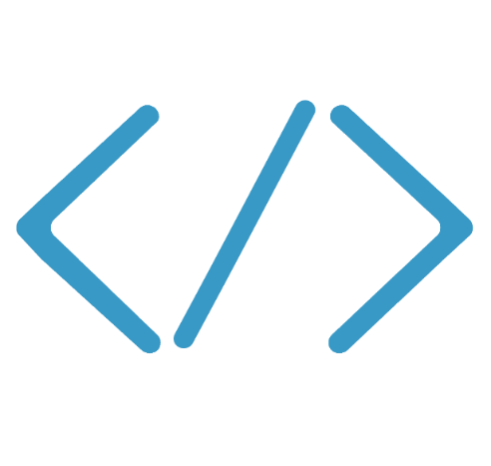

Introducing Functions
Code
Azure Functions
Events + data

Slide 14
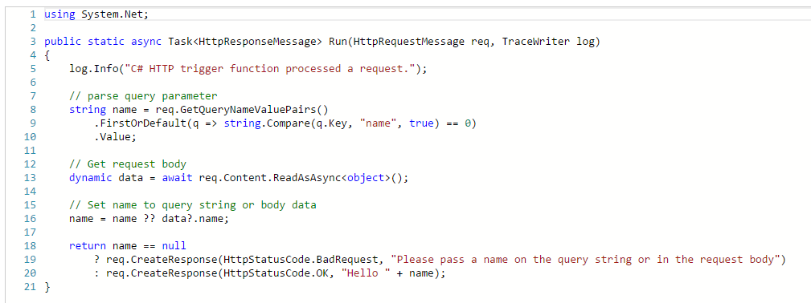
Programming Model
Trigger & Inputs
The Code
Outputs
Notes:
Most folks that get started with Azure Functions first start from the Azure Portal where we have a variety of features to help you get started quickly.

Slide 15
Azure Functions usage patterns
Great customer and community traction so far
“Brown field” – used as an integration, scripting tool (typically enterprises or larger ISVs)
“Green field” – used for backend creation (typically start-ups or smaller ISVs)
IoT – leveraged autonomously or as part of Azure IoT implementations

Slide 16
Hexagonal Architecture
EDIfact Adapter
AMQP Adapter
SOAP Adapter
Twilio
REST Adapter
A
A
A
A
Ports are logical artefacts.
Adapters are physical implementation of ports.
Port Layer
FTP
SERVICE
https://docs.microsoft.com/en-us/azure/azure-functions/functions-triggers-bindings
https://docs.microsoft.com/en-us/azure/azure-functions/functions-develop-vs#add-bindings

Slide 17
Use bindings in your code
run.csx
function.json
public static void Run(byte[] image, string filename,
Stream outputBlob, TraceWriter log)
{
log.Info($"Processing image: {filename}");
var imageBuilder = ImageResizer.ImageBuilder.Current;
imageBuilder.Build(
image, outputBlob,
new ResizeSettings(640, 400, FitMode.Max, null), false);
}
{
"bindings": [
{
"name": "image",
"type": "blobTrigger",
"direction": "in",
"path": "card-input/{filename}.jpg",
"connection": "AzureWebJobsStorage"
},
{
"type": "blob",
"name": "outputBlob",
"path": "card-output/{filename}.jpg",
"connection": "AzureWebJobsStorage",
"direction": "out"
}
]
}

Slide 18
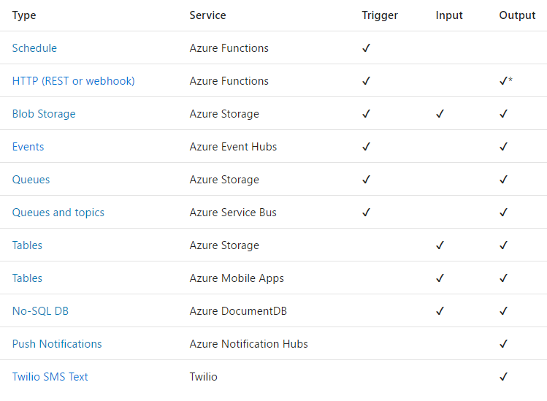
Triggers and Bindings
https://github.com/MicrosoftDocs/azure-docs/blob/master/articles/azure-functions/functions-host-json.md

Slide 19
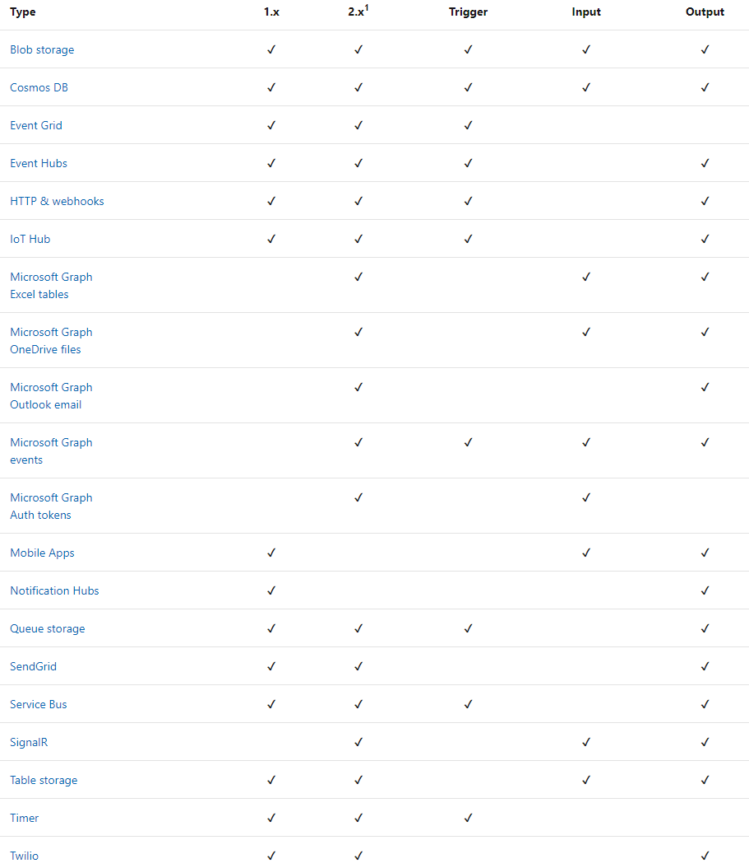
Triggers and Bindings
https://github.com/MicrosoftDocs/azure-docs/blob/master/articles/azure-functions/functions-host-json.md

Slide 20






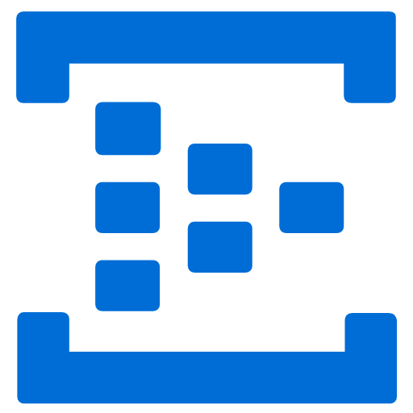
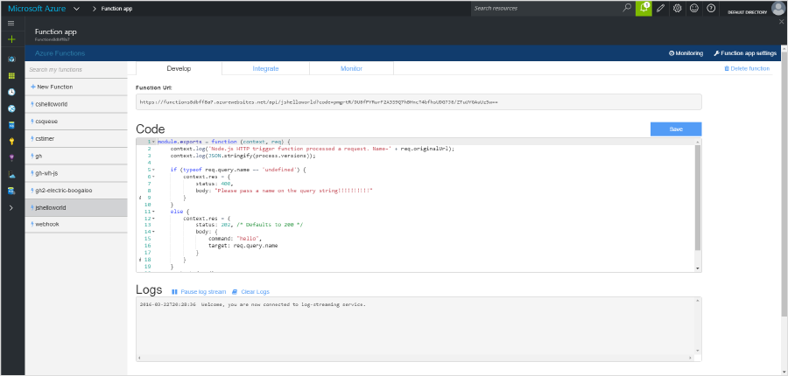
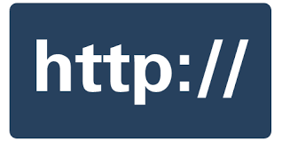




Seamless DevOps experience with Functions
1) Trigger
2) Input binding
3) Develop
4) Execute
5) Output binding
Web
Hooks
App Services
Hosting Plans
Azure Services
Azure Services
Azure Services
7) Develop locally
6) Monitor and improve
Notes:
This is the whole (top level) Dev Ops story where Dev build wounderful apps, using CI they mange their code, builds, and releases. Connecting to a repository, they can deploy to Azure Websites, build in the cloud, deploy to a slot to test and validate, swap into production, deployed across the globe as needed, monitor and get feedback, on which devs can make updates. Rinse and repeat

Slide 21
Hands-On
Azure Functions

Slide 22
Create Function (Portal)
https://docs.microsoft.com/en-us/azure/azure-functions/functions-create-first-azure-function
#r "Microsoft.WindowsAzure.Storage"
using System;
using Microsoft.WindowsAzure.Storage.Queue;
public static void Run(string myQueueItem, CloudQueue myOutQueueItem, ILogger log)
{
log.LogInformation($"C# Queue trigger function processed: {myQueueItem}");
myOutQueueItem.AddMessageAsync(new CloudQueueMessage($"{myQueueItem}")).Wait();
}
Notes:
{
"bindings": [
{
"name": "myQueueItem",
"type": "queueTrigger",
"direction": "in",
"queueName": "azfnc-inqueue",
"connection": "AzureWebJobsStorage"
},
{
"name": "myOutQueueItem",
"type": "queue",
"direction": "out",
"queueName": "azfnc-outqueue",
"connection": "AzureWebJobsStorage"
}
],
"disabled": false
}

Slide 23
Create Function (CLI)
func init MyFunctionProj
Tutorial: https://docs.microsoft.com/en-us/azure/azure-functions/functions-create-first-azure-function-azure-cli

Slide 24
Create Function (VS)
https://docs.microsoft.com/en-us/azure/azure-functions/functions-create-your-first-function-visual-studio
<PackageReference Include="Microsoft.Azure.WebJobs" Version="3.0.0-beta5" />
<PackageReference Include="Microsoft.Azure.WebJobs.ServiceBus" Version="3.0.0-beta5" />
<PackageReference Include="Microsoft.NET.Sdk.Functions" Version="1.0.14" />
https://docs.microsoft.com/en-us/azure/azure-functions/functions-bindings-service-bus#packages---functions-1x

Slide 25
Create Function (docker)
https://docs.microsoft.com/en-us/azure/azure-functions/functions-create-function-linux-custom-image
func init . --docker
Create AzFunction in docker container and run it anywhere.
func new
docker build -t myazfunc:v1 .
docker run –it –p 8080:80 myazfunc:v1
Create :Linux AppPlan (physical cluster)
Create function app and deploy container
az appservice plan create --name myAppServicePlan --resource-group myResourceGroup --sku B1 --is-linux
az functionapp create --name azfuncapp --storage-account <storage_name> --resource-group RG-MYFNC --plan myAppServiceFncPlan --deployment-container-image-name <docker-id>/mydockerimage:v1.0.0
Notes:
az appservice plan create --name azfuncdockerappplan --resource-group RG-MYFNC --sku B1 --is-linux
az functionapp create --name azurefuncapp --storage-account myazfncstorage --resource-group RG-MYFNC --plan azfuncdockerappplan --deployment-container-image-name damir.azurecr.io/azfunc:v1

Slide 26
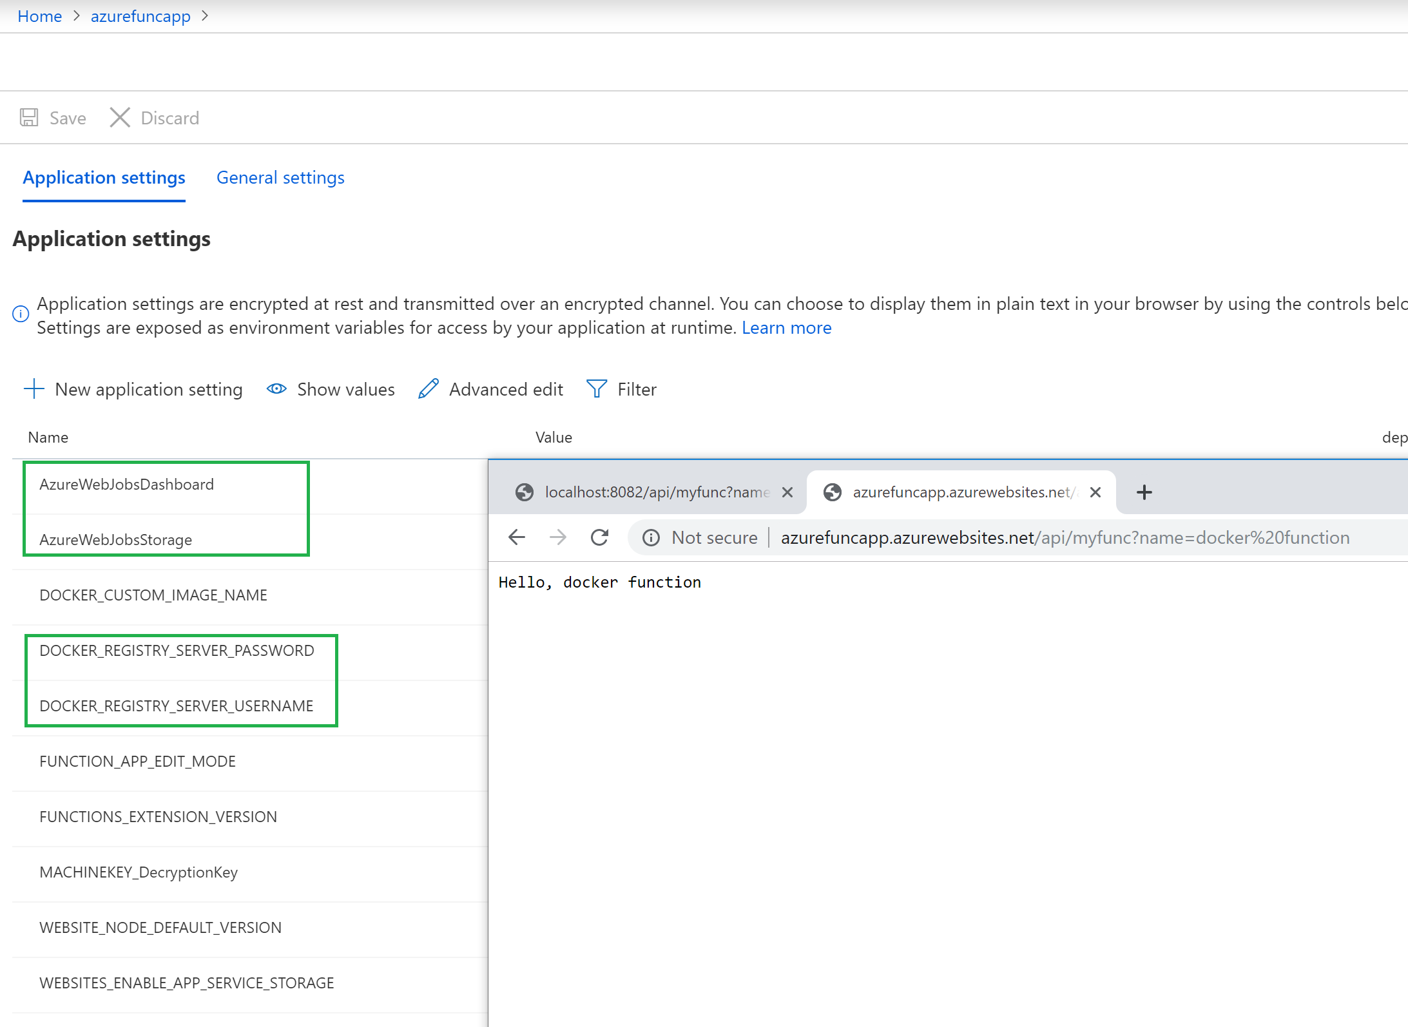
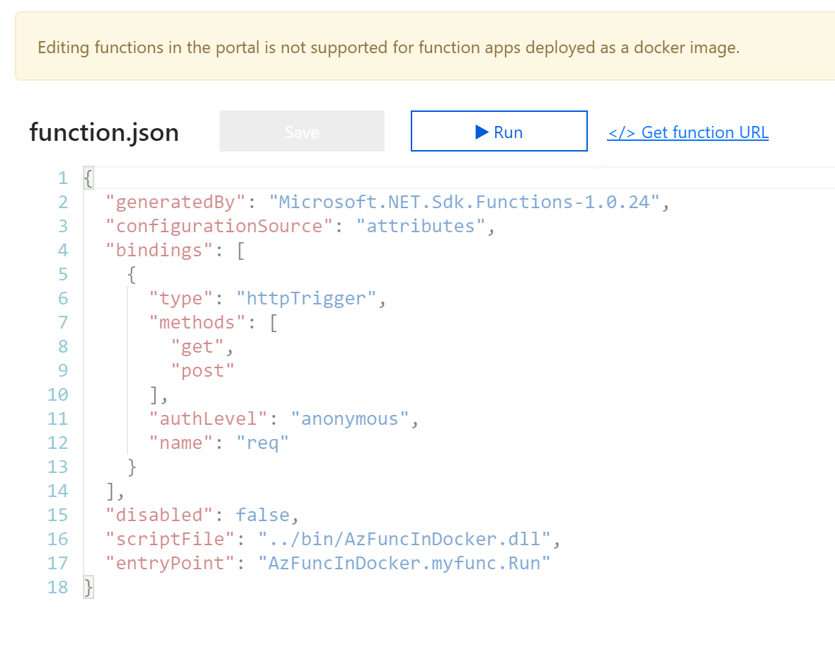
Create Function (docker)
Automatically populated by az functionapp create.
Navigate here to test application
If your registry is private one, you MUST add these settings.

Slide 27
Run Console in Azure Function
https://azure.microsoft.com/en-us/resources/samples/functions-dotnet-migrating-console-apps

Slide 28

Customer Success Stories
A popular online retailer was able to ship new features within…., which used to them xxx to do.
A large manufacturer was able to scale 3.6 times in a week to nearly 600 million events without scaling infrastructure.
https://github.com/Azure/Azure-Functions/wiki/Samples-and-content
Notes:
TIME MARKER: 11:10 A.M.

Slide 29
References //Build 2019
Closing the key gaps of serverless with Azure Functions - BRK3042
Mixing Stateful and Serverless – workflow orchestration and actors - THR3011
Serverless web apps with Blazor Azure Functions and Azure Storage - THR2003
Serverless Kubernetes KEDA and Azure Functions - PRE14
6 things you need to know about serverless - THR3009
Event-driven design patterns to enhance existing applications using Azure Functions - BRK3041
Serverless Python Applications with Azure Functions - PRE13
The good the bad and the ugly of Serverless - CFS2025
Bring serverless apps to life with Azure SignalR Service - THR3008

Slide 30
Logic Apps
Damir Dobric
daenet GmbH Microsoft Regional Director, Azure MVP Partner Technical Solution Professional

Slide 31
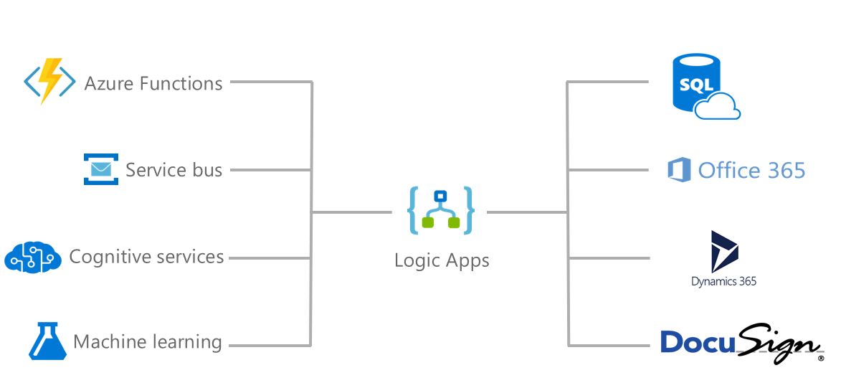
Introducing Azure Logic Apps
Powerful Integration and Workflow Engine in Azure
Notes:
-Started with BizTalk server (in for 17 years) – how can we move things faster between enterprise integration? LogicApps was born out 100% out of Azure.
-how to reduce integration from weeks/months to days?

Slide 32
Integration
BizTalk Server (xLANG)
Workflow Foundation (Process)
AppFabric (IIS Pool)
Workflow Manager (Process, Service Bus)
Durable Task Framework (Process, Service Bus)
LogicApps (ARM)
Flows (LogicApp)

Slide 33
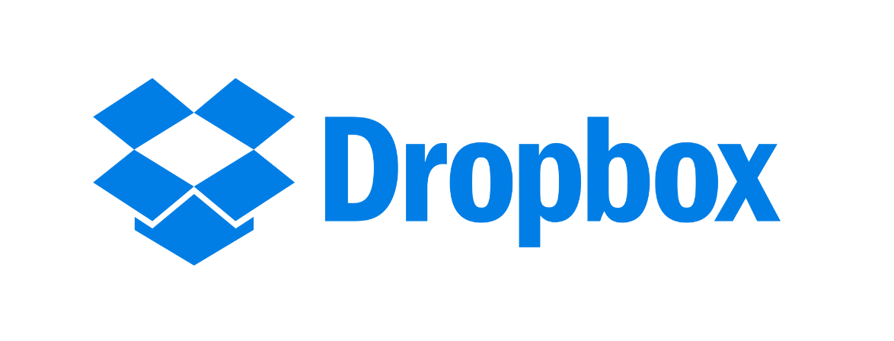


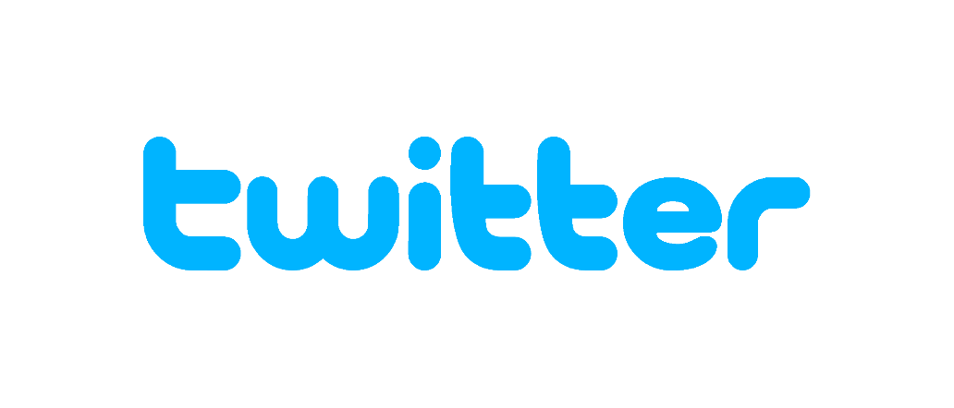


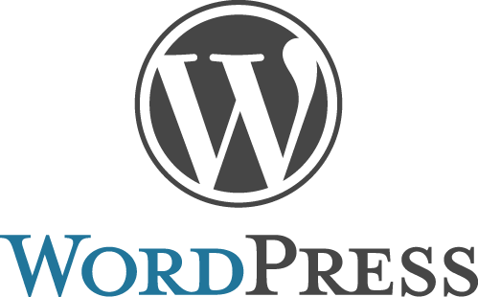
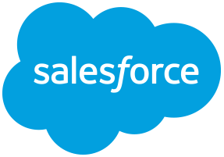
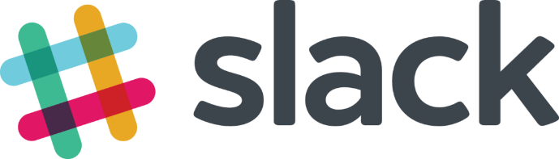
Logic apps connectors—Over 100 and growing
….and more!

Slide 34
Logic Apps
SaaS
Protocols/Native
appFigures
Asana
Azure API Management
Azure App Services
Azure Automation
Azure Cognitive Face API
Azure Cognitive LUIS
Azure Cognitive Text Analytics
Azure Cognitive Vision
Azure Data Lake Store
Azure Document DB
Azure Event Hub
Azure Functions
Azure Machine Learning
Azure Resource Manager
Azure Service Bus
Azure SQL
Azure Storage Blob
Azure Storage Queues
Basecamp
Bing Search
BitBucket
Bitly
Blogger
Box
Buffer
Campfire
Chatter
Common Data Service
Disqus
DocuSign
Dropbox
Dynamics AX Online
Dynamics CRM Online
Dynamics CRM Service Bus
Dynamics Financials
Dynamics Operations
Easy Redmine
Eventbrite
Facebook
FreshBooks
Freshdesk
GitHub
Gmail
Google Calendar
Google Contacts
Google Drive
Google Sheets
Google Tasks
GoTo Meeting
GoTo Training
GoTo Webinar
Harvest
HelloSign
Infusionsoft
JIRA
Insightly
Instagram
Instapaper
MailChimp
Mandrill
Medium
Microsoft Project Online
Microsoft Translator
MSN Weather
Muhimbi PDF
Office 365
Office 365 Users
Office 365 Video
OneDrive
OneDrive for Business
OneNote
Outlook.com
Outlook Tasks
PagerDuty
Pinterest
Pipedrive
Pivotal Tracker
Power BI
Project Online
Redmine
Salesforce
Salesforce Chatter
SendGrid
SharePoint Online
Slack
SmartSheet
SparkPost
Stripe
Survey Monkey
Todoist
Toodledo
Trello
Twilio
Twitter
Typeform
UserVoice
VS Team Services
Webmerge
Wordpress
Wunderlist
Yammer
YouTube
Zendesk
HTTP, HTTPS
HTTP Webhook
FTP, SFTP
SMTP
RSS
Compose, Query, Parse JSON
Wait
Terminate
Workflow
Cloud APIs and platform functionality
Over 120 built-in connectors
Hosted and managed within the platform
Scales to meet your needs
First class designer experience
Rapid development
XML and EDI
XML Validation
Transform XML (+Mapper)
Flat File Encode
Flat File Decode
X12
EDIFACT
AS2
Integration Account Artifact Lookup
API connections
Authenticate once and reuse
Differentiate connection configuration
Simple to deploy
Portal experience for managing API Connections
Hybrid
BizTalk Server
File System
IBM DB2
Informix
Oracle DB
SharePoint Server
SQL Server
SAP
Websphere MQ
Notes:
Call out that we now support stored procs on-prem

Slide 35
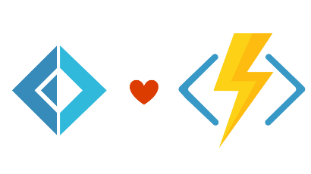


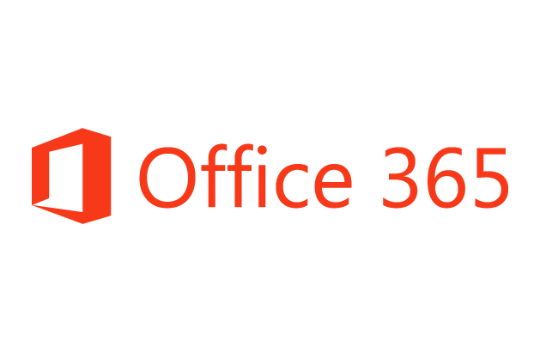
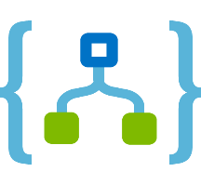
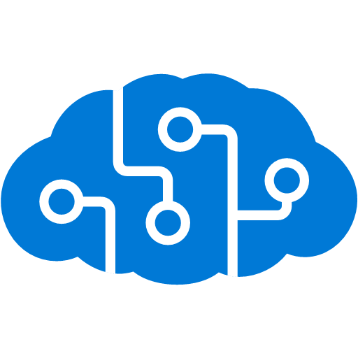
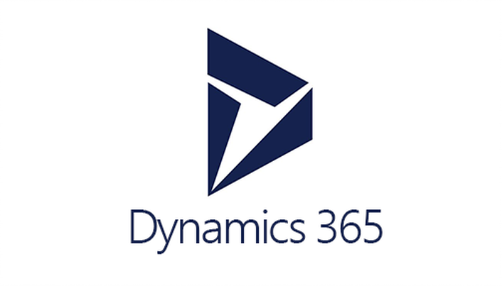



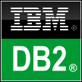
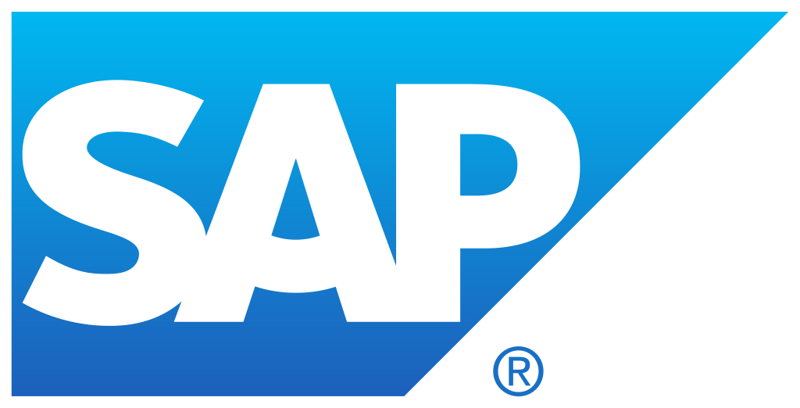


Logic Apps connects everything
Azure Functions
Service bus
Cognitive services
Logic Apps
Machine learning
On-premises data gateway
BizTalk server
Notes:
Logic Apps can integrate with “anything” (APIs) and solve small or complex problems. Automation in a secure and reliable environment fast and easy.
Connect Anything:
On-premises, hybrid and cloud
Mission critical, complex integration scenarios
Business productivity
Agile Business:
Quickly create workflows
Position to the future API centric
Transform Business:
Extract value from both (on-premises and cloud apps)
Build Holistic integration solutions.

Slide 36
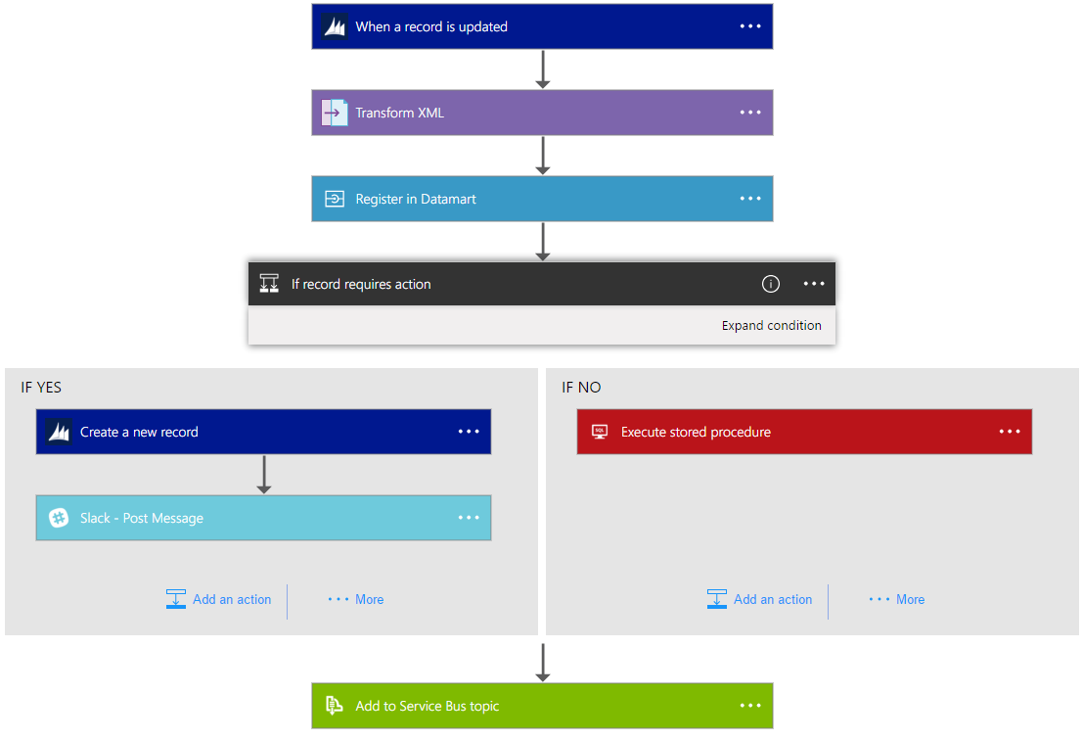
Logic Apps Workflow Designer
Workflow in the cloud
Powerful control flow
Connect disparate applications
No code designer for rapid creation
Also works within Visual Studio for added CI/CD

Slide 37
Scenario 1 Real time Stream Analytics

Slide 38

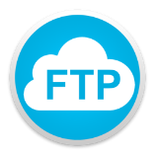


Real-time stream analytics
Tasks/activities
Before serverless
Using serverless
Replicate logs from one data center to another
Analyze the logs
Take action based on data
Setup a VM/Container/WebJobs
Build/patch/deploy (OS)
Monitor infra (VM/Container)
Manage FTP creds
Use FTP library
Use Azure SDK
Setup a VM/Container/WebJobs
Build/patch/deploy (OS)
Monitor infra (VM/Container)
Manage FTP with dynamic settings (automation)
Use FTP library
Notes:
Case study: https://cloud.microsoft.com/en-us/customer-stories/accuweather/
Quote from Christopher Patti/AccuWeather: “The API logging work we were doing has almost always been Azure side, but from there we are seeing thousands of dollars a month of reduced cost since we do not need a dedicated Iaas VM with a ton of storage. Over time, the savings will be more significant since we will decommission physical/virtual on-premise servers, but we aren’t there yet.”
Business challenge: managing 17 Billion data requests per day globally

Slide 39
Scenario 2 Geo based marketing

Slide 40

Geo-based marketing
Tasks/activities
Before serverless
Using serverless
Stream logs to event ingestion engine
Analyze the logs and live POS feed
Push custom notifications based on data
Setup a VM/Container/WebJobs
Build/patch/deploy (OS)
Monitor infra (VM/Container)
Connect to partner integration system
Ingest data logs
Analyze logs and live POS feed
Push custom notifications
Infrastructure customization
Setup a VM/Container/WebJobs
Build/patch/deploy (OS)
Monitor infra (VM/Container)
Connect to partner integration system
Ingest data logs
Analyze logs and live POS feed
Push custom notifications
Notes:
The awesome thing that Plexure has done is that they not only utilize these services to help process events from their own platform, but they actually offer the ability for their own users to write Functions within their UX to use as part of a workflow. (I’ll spend some time here to let the impact of that sink in)
A customer walks into a store to do their shopping. With partner integration (GE indoor positioning) we are able to track the customer's route through the store and in addition identify the zones within the store that the customer has dwelled (spent a longer than average time in the section) in. As an example we now know the Susan walked through the store but dwelled the longest in the wine section.
Now when the customer has gone to the till and scanned their goods we get a live pos feed of their cart. Using this workflow we marry the customers dwell times and the cart information to offer the customer the most relevant product based on their behaviour in the store. Carrying on with our example Susan we see Susan bought a line fish, but did not buy any wine that pairs with the fish even though she dwelled in the wine section. We can now push a message to her telling her that she should pair her fish with a nice bottle of souvenir blanc.
The story here is we needed the ability to integrate and filter complex results from a partners API to a format that we could easily process within our workflow.

Slide 41

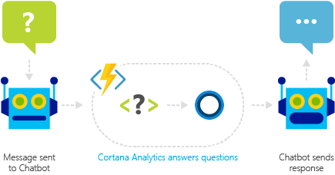





Plexure architecture diagram
Event ingestion engine
Push notifications
Intelligence pipeline
Notification Hubs

Slide 42
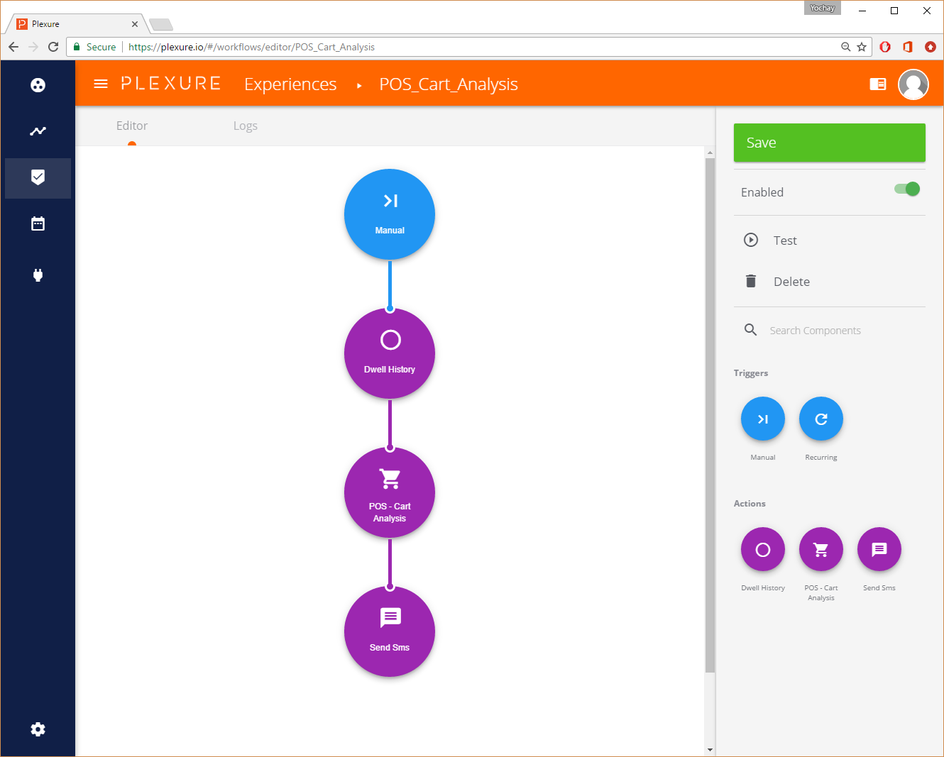
Plexure Workflow: Logic Apps as Backend

Slide 43
The Child Finder Bot
Scenario 3
Missing Children Society of Canada

Slide 44





The Missing Children Project
Notes:
Detailed case study links
https://microsoft.github.io/techcasestudies/devops/azure%20app%20service/mobile%20application%20development%20with%20xamarin/2017/01/31/MissingChildrenSocietyofCanada.html
https://blogs.technet.microsoft.com/canitpro/2016/12/14/cloud4good-extracting-data-from-the-twitter-api-through-azure-functions/
The reality
Last year, 45,000 children went missing in Canada
6 resulted in Amber alert
The challenge
Kids’ information can fall in the wrong hands in social spheres. Acquiring and reporting such critical information (such as last-known whereabouts and contacts) to local law enforcement is difficult.
The game changer:
“The Child Finder” mobile app and web portal were built in 4 days to register a child, detect social sentiment, share information and alert both law enforcement and MCSC to take immediate actions.

Slide 45
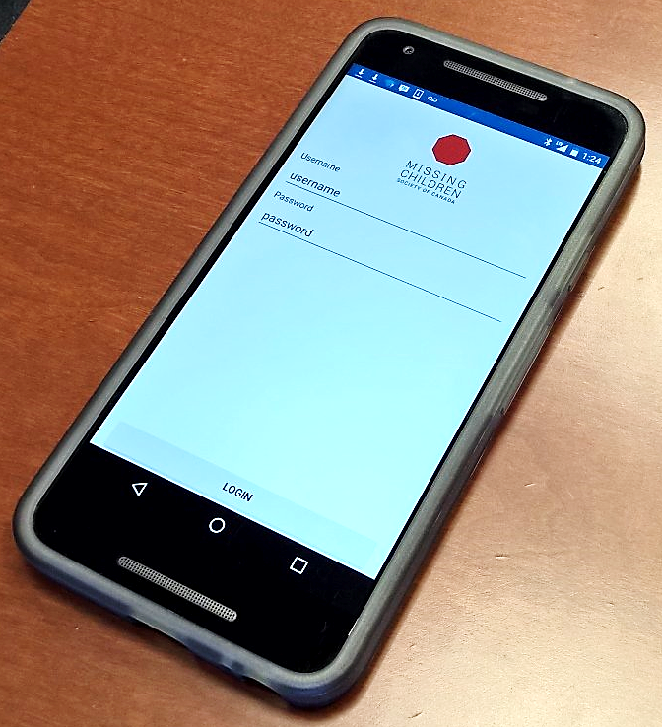
The Child Finder Bot
Twitter #HFM
Logic app
Service bus queue
Function: filter
Yes
Service bus queue
Function: augment
Twitter API
Service bus queue
Function: store
Document DB
Stop
Notes:
*MCSC: Missing Children Society of Canada
The goal:
Enable MCSC to extract last-known coordinates, who the child was in contact with, and the sentiment of conversation from social-media platforms such as Twitter and Facebook, save to Missing Children’s databases and alert police enforcement.
Tools used
Azure Functions
Azure Storage
Continuous Integration
Infrastructure as Code
Visual Studio Team Services
Xamarin Tools

Slide 46
Customer Success Stories
A popular online retailer was able to ship new features within…., which used to them xxx to do.
A large manufacturer was able to scale 3.6 times in a week to nearly 600 million events without scaling infrastructure.
Notes:
TIME MARKER: 11:10 A.M.

Slide 47
Build apps faster
Functions
Logic Apps
Consumption and provisioned options
Local development and advanced DevOps with detailed monitoring
Bindings to first and third-party services
Open source runtime
Rich portal visual designer and Visual Studio integration
Switch statements and loops
120+ connectors to SaaS and PaaS, with custom connector support
ARM template-based for easy reuse
Notes:
TIME MARKER: 11:20 A.M.

Slide 48
Increased developer productivity
Jump start your development
Build rich business apps
Pre-built templates
Integrate with PowerApps and CDS*
Automatic triggers
Integrate with Microsoft Flow*
Declarative bindings
Git/GitHub integration
Use existing development skills
Orchestrate workflows easily
Rich development tools
Graphical visual designer
IDE support for visual studio
Over 100+ connectors
F5 and visual debugging
Edit, author, visualize workflows easily
Verbose debugging
Quickly orchestrate multiple functions
Local SDK/runtime

Slide 49
Where does Serverless sit?
Innovation
Serverless
VALUE TO BUSINESS
PaaS
Efficiency
IaaS
TIME
Notes:
Note:4/3/2017
The talking points are in slide 12 in the Serverless section.

Slide 50
Serverless application platform
INNOVATE FASTER—PAY LESS
Build apps faster
Enable business agility
Reduce IT spend
Reduce development effort
Build rich business and LOB apps
Orchestrate a Serverless app in minutes
Continuous deployment
Leverage existing development skills
Build microservices
Continuous auto-scaling
Fully managed infrastructure
Micro-billing
Notes:
At MSFT, we focus on 3 core principles as we think through our Serverless application platform:
Build apps faster:
MSFT’s Serverless application platform offers tools that increase developer productivity, enabling businesses to hugely reduce development efforts. Quick start developer resources such as templates and declarative bindings for many Azure and 3rd party services, building functions on Mac or Linux environments, on-premises or hybrid topologies are few examples that help reduce overall development effort.
Functions integrates with Powerapps and Microsoft Flow to enable business users to build rich applications and automate business processes.
Developers can also leverage numerous out of the box connectors to SaaS and enterprise applications such as Salesforce, Box, DropBox etc to quickly connect to over 100+ SaaS services. By leveraging the visual designer and connectors in Logic Apps, customers can build a Serverless app in minutes by orchestrating multiple functions.
Enable business agility:
Continuous deployment and managing multiple environments, leveraging existing development tools and languages such as C#, Node.js and more.
Moving away from building monolithic applications to more light weight distributed components has been the most essential criteria for business agility. Functions enables developers to deploy microservices separately and also easily manage versions/ backend system changes using API Proxies.
Reduce IT Spend:
Since customers don’t have to worry about infrastructure management such as provisioning and managing servers, MSFT Serverless platform offers great benefits at significantly low costs for businesses.
The event triggered programming model allows customers to only pay for the compute capacity that was utilized. It offers infinite scalability, but only depending on the size of the workload and when an event is triggered. This enables micro-billing capability and hence customers are now only paying for what they use.

Slide 51
Scenario 4 New application creation

Slide 52

New App creation
Tasks/activities
Before Serverless
Using Serverless
Write a new web application
Setup a VM/Container/WebJobs
Setup a VM/Container/WebJobs
Build/patch/deploy (OS)
Build/patch/deploy (OS)
Collect student data
Monitor infra
Monitor infra
Co-relate student ID to student names
Deploy WPF application
Store student name and attendance information
Deploy WPF application
Use RFID card reader to collect student IDs
Collect student ID from USB RFID reader
Co-relate student ID to names and student records
Co-relate student ID to names and student records
Store student and attendance information in table storage
Store student and attendance information in table storage

Slide 53


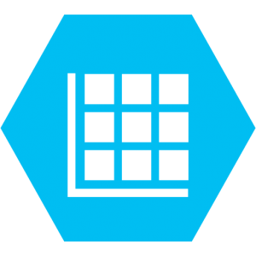
ClickOnce Application Update
Developer
Azure CI/CD
CSV
Faculty
Students
Windows App reading student RFID Cards

Slide 54






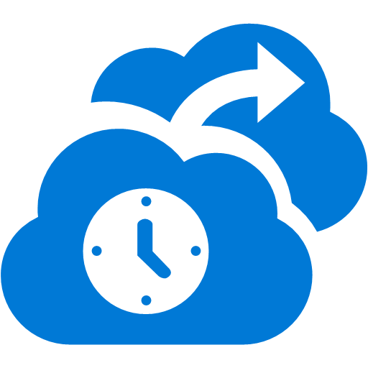

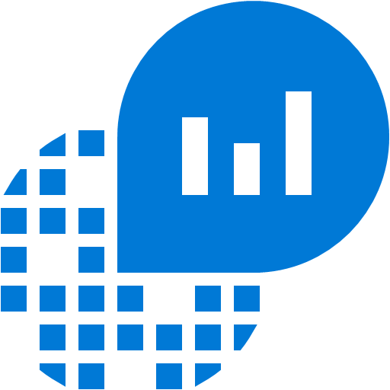


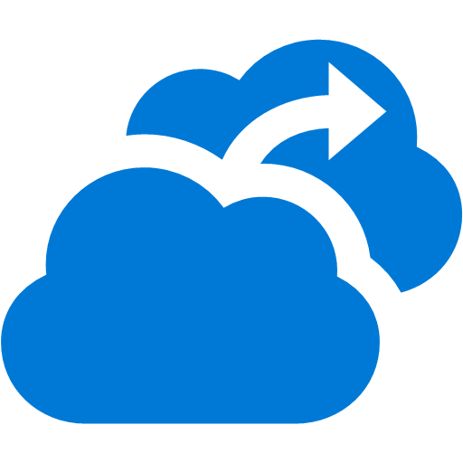






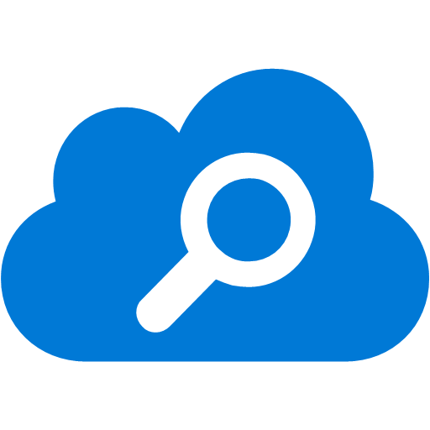
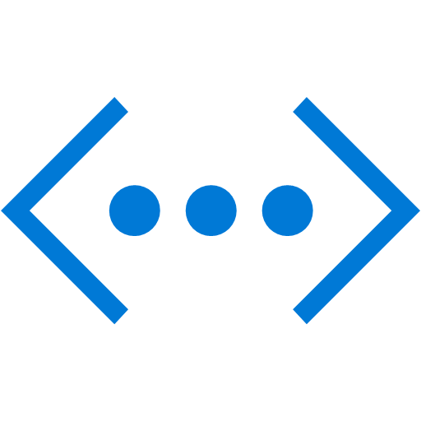


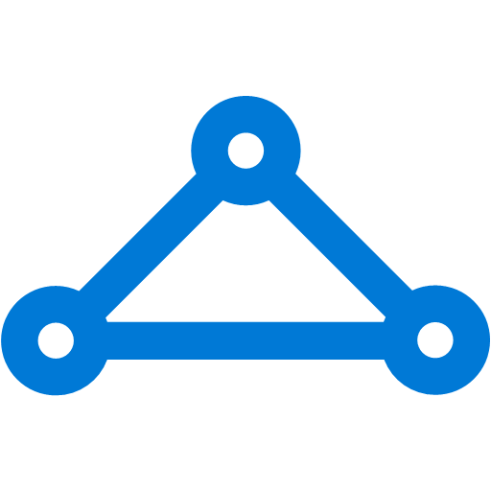


Functions: accelerate cloud development
Hybrid Operations
Security & Management
Azure AD
Connect Health
App Service
Batch
Cloud Services
Service Fabric
Remote App
AD Privileged
Identity Mngt
Portal
Compute
Backup
Active
Directory
Operational
Insights
Multi-Factor
Authentication
Web Apps
Mobile Apps
Web apps that scale with your business
Azure Functions
Build Mobile apps for any device
Import/Export
Listen and react to events across your stack
Automation
Site
Recovery
Key Vault
StorSimple
Store /
Marketplace
LOGIC Apps
API Apps & APIM
Data
VM Image Gallery
& VM Depot
Automate business process across SaaS and on-premises
Easily build and consume APIs in the cloud
SQL
Database
SQL Data
Warehouse
Storage
Networking
Redis
Cache
Search
BLOB Storage
Azure Files
Premium Storage
Virtual Network
Load Balancer
DNS
Express
Route
Traffic Manager
VPN Gateway
Application Gateway
DocumentDB
Tables
Notes:
Scenarios we are seeing: cloud system integration between Azure components. Huge time saver

Slide 55
Evolution of Compute Platform
Docker
.NET Core in containers
Azure Container Registry
Azure Container instances
AppService Container
Azure Functions
Service Bus and messaging
EventGrid
Logic Apps

